Slide 1
Climate Data Modeling and semantic Analysis
Visualization of Variables reflecting change in climate.
Visualizing disasters at different regions.
Semantic analysis of thoughts on climate change.
Fitting Random Forest, Multiple Linear Regression and LSTM to forecast climate associated variables.

Slide 2
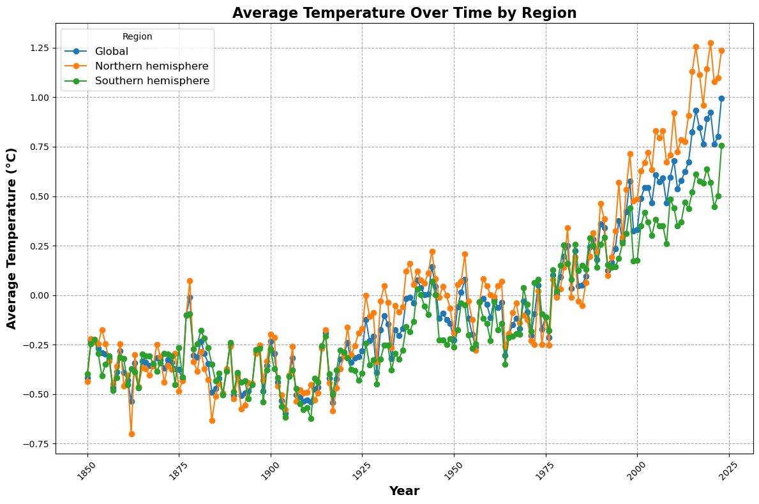
Global Temperature Trends Over Time
Key Findings:
The graph clearly demonstrates a significant increase in average global temperature over time. This warming trend is a strong indicator of climate change.
The rate of temperature increase appears to be accelerating, especially in recent decades.
The northern hemisphere has experienced a slightly more pronounced temperature increase compared to the southern hemisphere. This could be attributed to factors like landmass distribution and human activities, which are concentrated in the northern hemisphere.

Slide 3
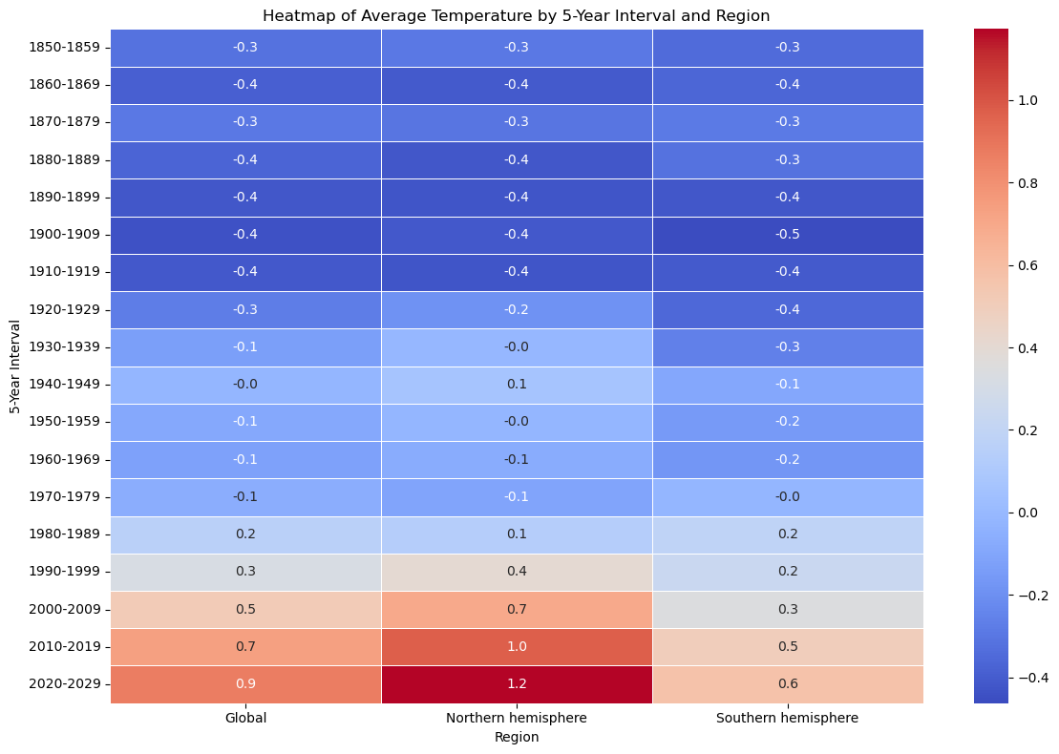
Heatmap of Average Temperature by 5-Year Interval and Region
The graph clearly shows a general upward trend in average global, northern hemisphere, and southern hemisphere temperatures over time. This indicates a warming trend consistent with climate change. While the southern hemisphere has also warmed, the rate of increase is generally lower than in the northern hemisphere.

Slide 4
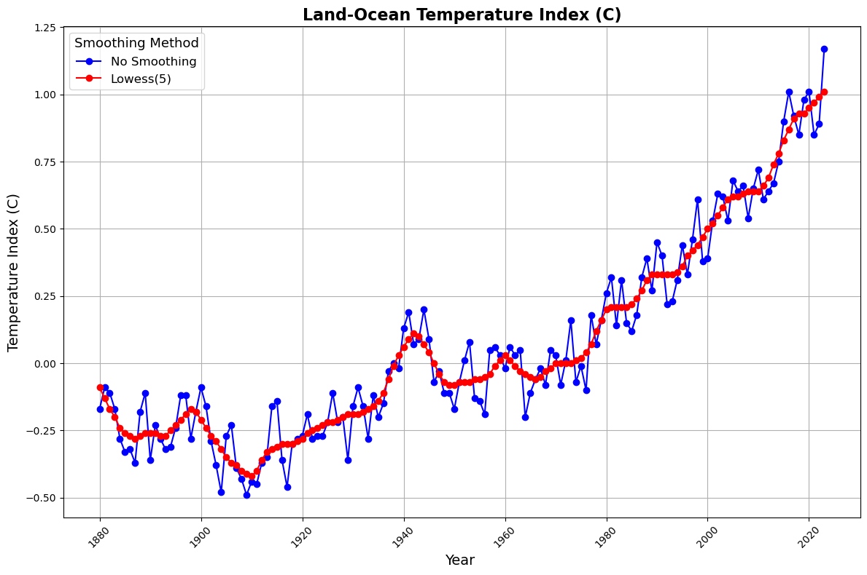
Land-Ocean Temperature Index (Celsius)
The graph clearly shows a general upward trend in the Land-Ocean Temperature Index (LOTI) over time, indicating a warming trend.
The blue line, representing the LOTI without smoothing, shows more fluctuations and variations. This is because it includes the raw data points without any adjustments.
The red line, using the Lowess smoothing method with a span of 5, provides a smoother curve. This helps to highlight the underlying trend and reduce the impact of short-term fluctuations.

Slide 5
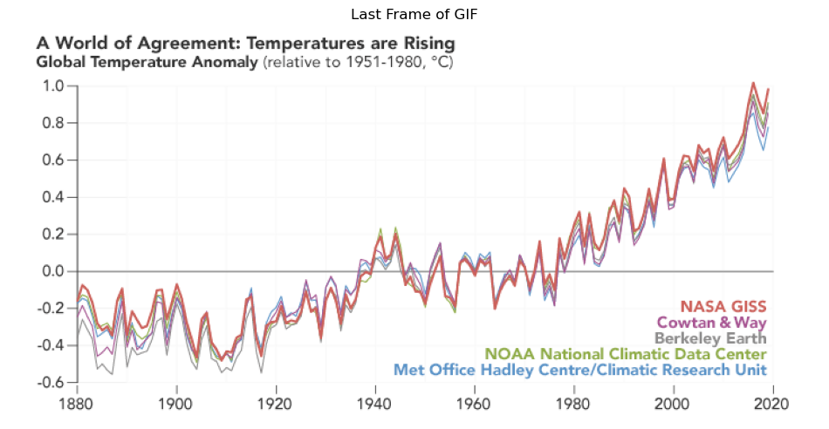
Global Temperature Study by Different Authorities
The graph includes data from five different scientific organizations: NASA GISS, Cowtan & Way, Berkeley Earth, NOAA National Climatic Data Centre, and Met Office Hadley Centre/Climatic Research Unit. The convergence of these independent datasets strengthens the confidence in the observed warming trend.
It's important to note that the organizations are not directly measuring temperature but rather analyzing and processing data from various sources. Therefore, the slight differences between the datasets are likely due to variations in data processing methods, data sources, and other factors.

Slide 6
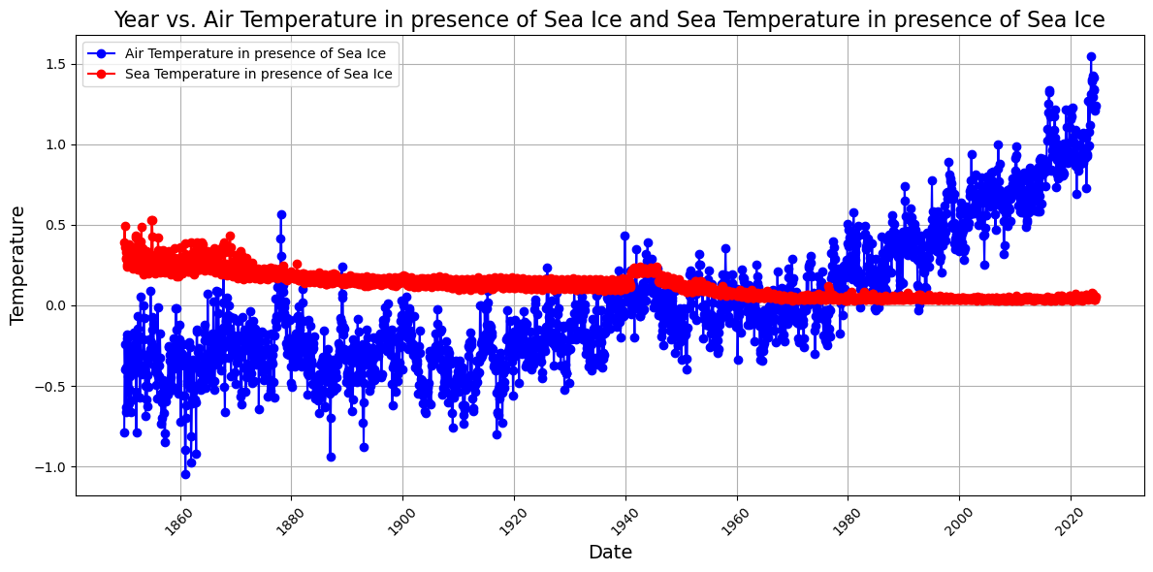
Impact of Sea Ice on Air and Sea Temperature
The graph provides evidence of a warming trend in air temperature above sea ice, which is likely a result of climate change.
The air temperature anomalies (blue line) are generally higher than the sea temperature anomalies (red line), especially in recent decades. The air temperature in the presence of sea ice has experienced a more significant increase compared to the sea temperature in the presence of sea ice. This suggests that air temperatures above sea ice have been warming at a faster rate than the underlying water temperatures.

Slide 7
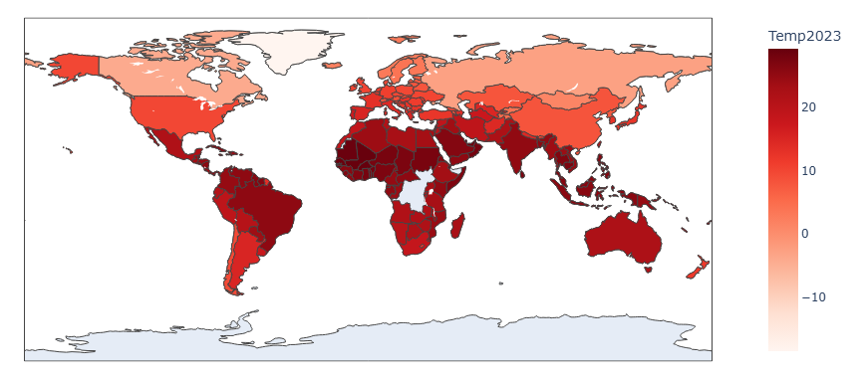
Average Temperature of Countries in 2023'
Tropical Regions: Countries near the equator, such as those in Africa, South America, and Southeast Asia, generally have higher average temperatures.
Temperate Regions: Countries in North America, Europe, and parts of Asia exhibit a range of temperatures, with some regions experiencing warmer conditions and others experiencing cooler conditions.
Polar Regions: As expected, countries in the Arctic and Antarctic regions have the lowest average temperatures.
The differences in temperature between tropical, temperate, and polar regions are primarily due to the Earth's tilt, rotation, and the way sunlight is distributed across different latitudes.

Slide 8
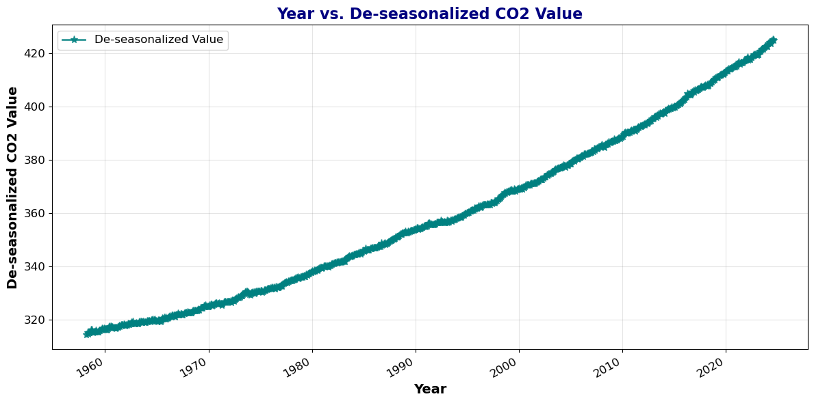
De-seasonal zed Carbon Dioxide Emission Over Years
The graph clearly shows a steady and significant increase in de-seasonal zed CO2 values over time. This indicates a long-term trend of rising atmospheric carbon dioxide concentrations.

Slide 9
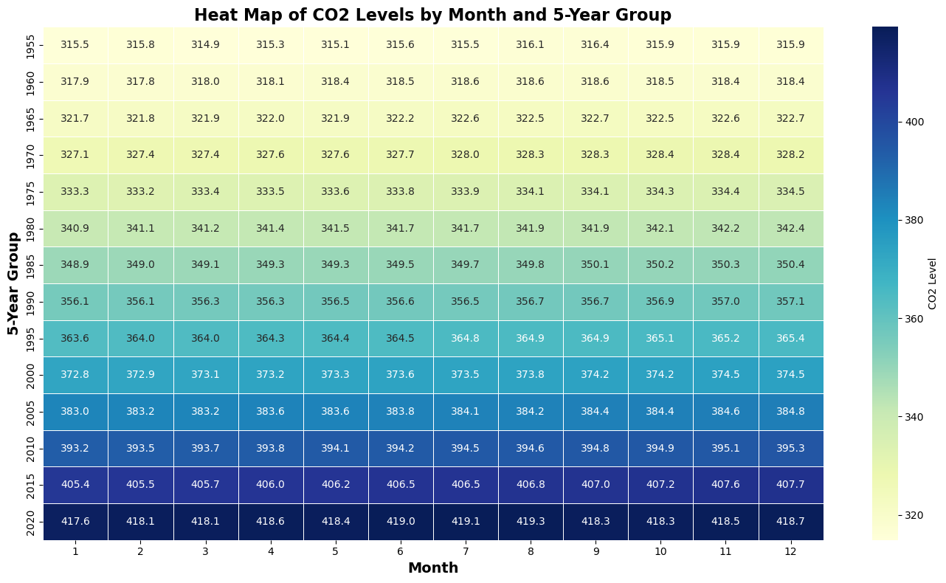
Levels
Heat Map of CO2 Levels by Month and 5-Year Group
The Heatmap reveals a distinct seasonal pattern in CO2 levels. Concentrations tend to be higher in the late spring and early summer (April-June) and lower in the late fall and early winter (October-December). This is primarily due to seasonal variations in plant growth and respiration.

Slide 10
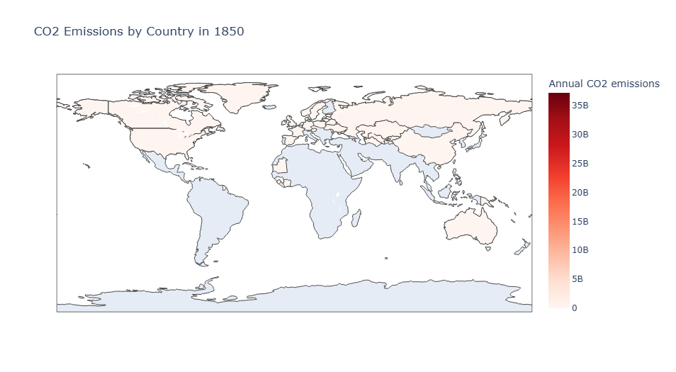
Carbon Dioxide Emission by Continents in 1850
Developed Nations: The majority of CO2 emissions in 1850 appear to be concentrated in industrialized nations, particularly in Europe and North America.
Low Emissions in Developing Countries: Developing countries, especially in Africa and Asia, had relatively low CO2 emissions at this time.
Europe: European countries, such as the United Kingdom and France, appear to be among the largest emitters.
North America: The United States seems to be a significant contributor to global emissions.

Slide 11
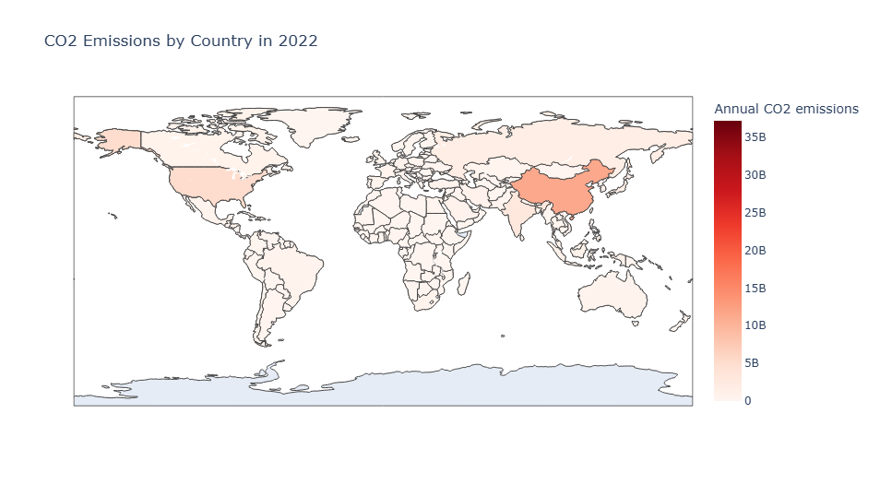
Carbon Dioxide Emission by Continents in 2022
Shift Towards Asia: Compared to the 1850 map, there has been a significant shift in the distribution of CO2 emissions. China and India have become major emitters, surpassing many European and North American countries.
Increased Emissions in Developing Countries: Developing countries in Asia, Africa, and South America have experienced substantial increases in CO2 emissions, reflecting their rapid industrialization and economic growth.
China and India: These two countries have emerged as the world's largest emitters, contributing significantly to global CO2 emissions.
United States: While still a major emitter, the United States has seen a relative decline in emissions compared to its peak.

Slide 12
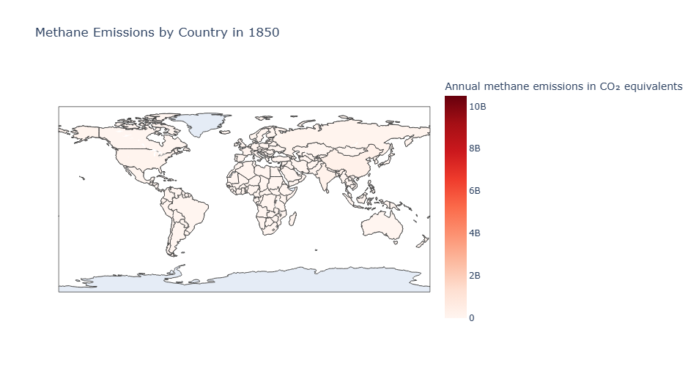

Methane Emission by Continents in 1850 and 2022
Annual methane emissions in CO₂ equivalents" refers to the total impact of methane emissions expressed in terms of carbon dioxide (CO₂) equivalents. This is done to standardize the effect of different greenhouse gases based on their global warming potential (GWP).

Slide 13
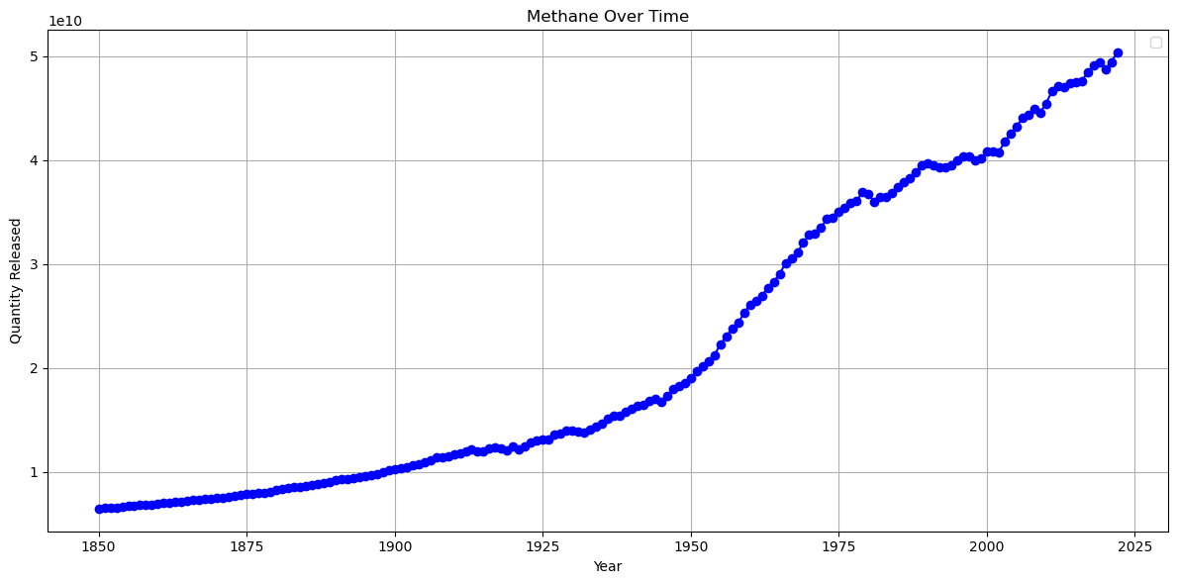
Total Methane Emission
The graph clearly shows a steady and significant increase in methane emissions over time. This indicates a long-term trend of rising atmospheric methane concentrations.

Slide 14
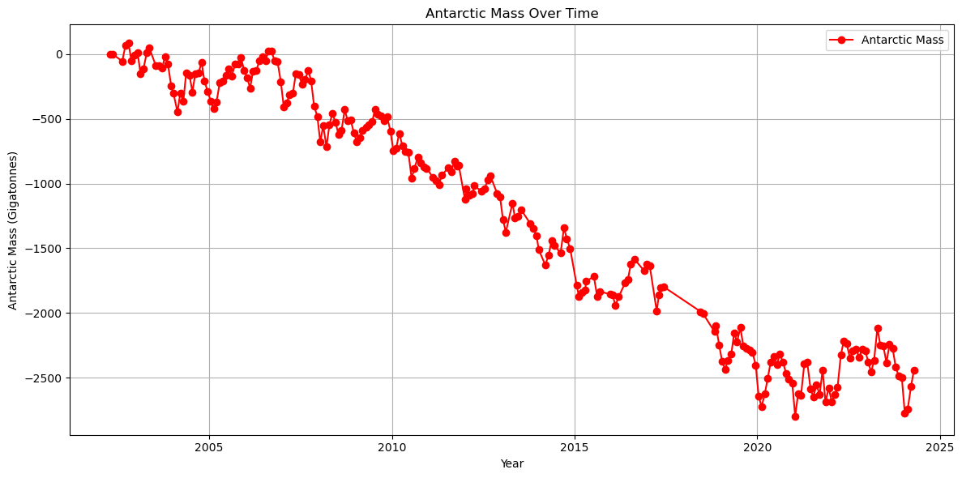
Antarctica Ice Mass
The graph clearly shows a general downward trend in Antarctic mass over time, indicating a loss of ice mass in the Antarctic region.
The loss of Antarctic ice contributes to sea level rise, affecting coastal communities and ecosystems worldwide.
The decline in Antarctic mass is a clear indicator of climate change and its impacts on polar regions.
Changes in Antarctic ice mass can influence ocean circulation patterns, which can have far-reaching effects on global climate systems

Slide 15
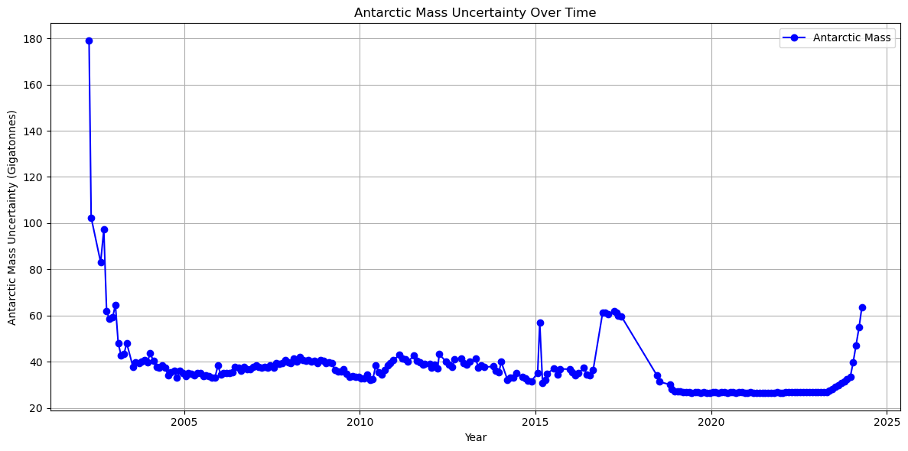
Antarctic Mass Uncertainty Over Time
The graph shows significant fluctuations in the uncertainty associated with Antarctic mass measurements over time. This indicates that the precision and accuracy of these measurements have varied.

Slide 16
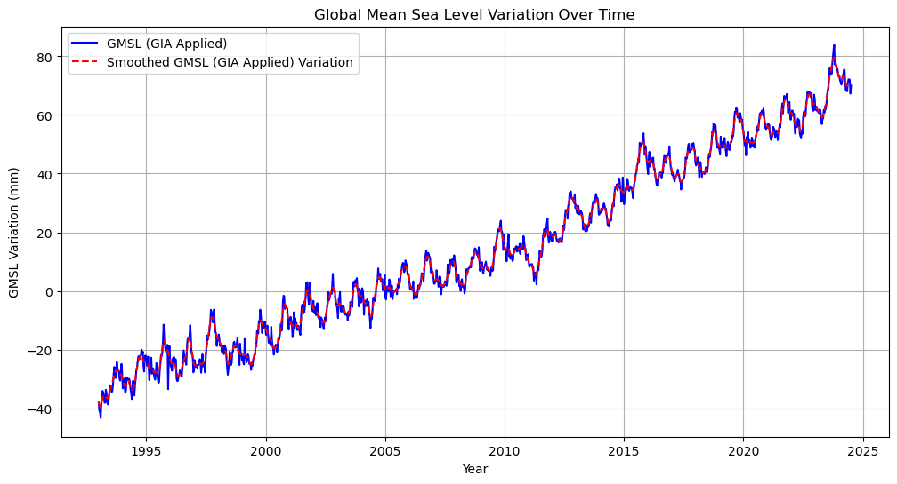
Sea Level Rise
The graph clearly shows a general upward trend in global mean sea level (GMSL) over time, indicating a rise in sea levels.
GMSL (GIA Applied): The blue line represents the raw GMSL data with glacial is-static adjustment (GIA) applied. This adjusts the data for the effects of post-glacial rebound, which can cause regional variations in sea level.
Smoothed GMSL (GIA Applied) Variation: The red line represents a smoothed version of the GMSL data, which helps to highlight the overall trend and reduce the impact of short-term fluctuations.

Slide 17
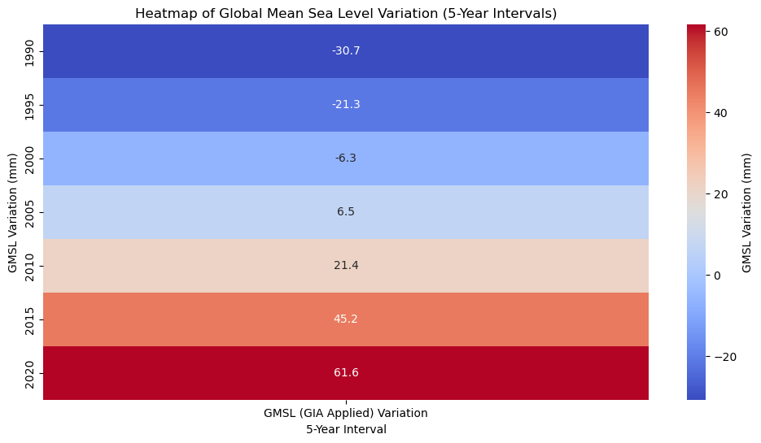
Heatmap of Global Mean Sea Level Variation
The Heatmap clearly shows a general upward trend in global mean sea level (GMSL) variation over time. The colours representing higher sea level rise become more prevalent in the later 5-year intervals.
Upward Trend: The Heatmap clearly shows a upward trend in global mean sea level variation over time. The colours representing higher sea level rise become more prevalent in the later 5-year intervals.
Increasing Rate of Rise: The most recent 5-year intervals (2010-2014, 2015-2019, and 2020-2024) exhibit a particularly rapid increase in sea level rise, as indicated by the more intense red hues.
Historical Context: The earlier time periods (1990-1994, 1995-1999) show lower rates of sea level rise, providing a historical context for the subsequent acceleration.

Slide 18
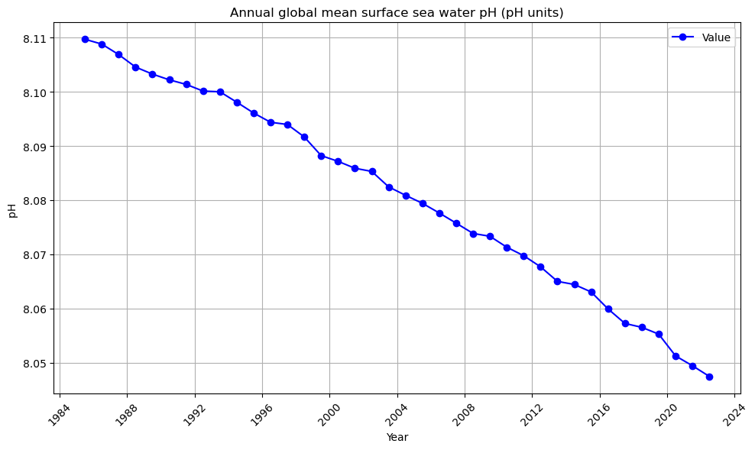
Ocean Acidification
Key Findings:
Decreasing pH: The graph clearly shows a downward trend in the annual global mean surface seawater pH over time. This indicates a decrease in ocean pH, which is known as ocean acidification.
Rate of Decrease: The rate of pH decrease appears to be accelerating, especially in recent decades. This suggests that the acidification process is intensifying.

Slide 19
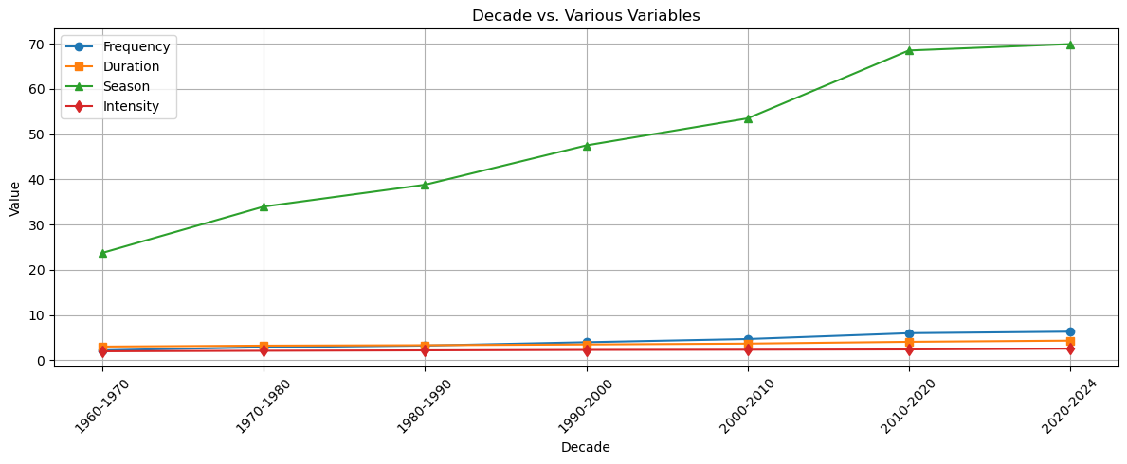
Heat Wave
Frequency (average number of heat waves per year) Duration (average number of individual heat waves) Season (average length of annual heat wave season) Intensity (average temperature above local threshold during heat waves)
The graph shows a clear upward trend in both frequency and intensity over time. This suggests that the occurrence and severity of heat wave have been increasing in recent decades.

Slide 20
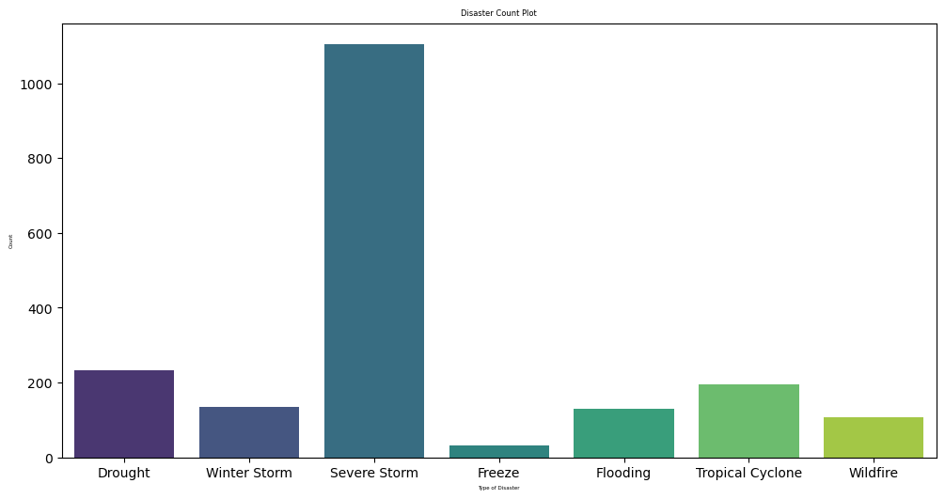
Extreme Weather Events / Disasters
Severe Storm: The plot clearly shows that severe storms are the most prevalent disaster type, with a significantly higher count compared to other categories.
Drought and Winter Storm: Drought and winter storms have relatively higher frequencies compared to freeze, flooding, tropical cyclones, and wildfires.
Lower Frequency Disasters: Freeze, flooding, tropical cyclones, and wildfires have lower counts, indicating less frequent occurrences.

Slide 21
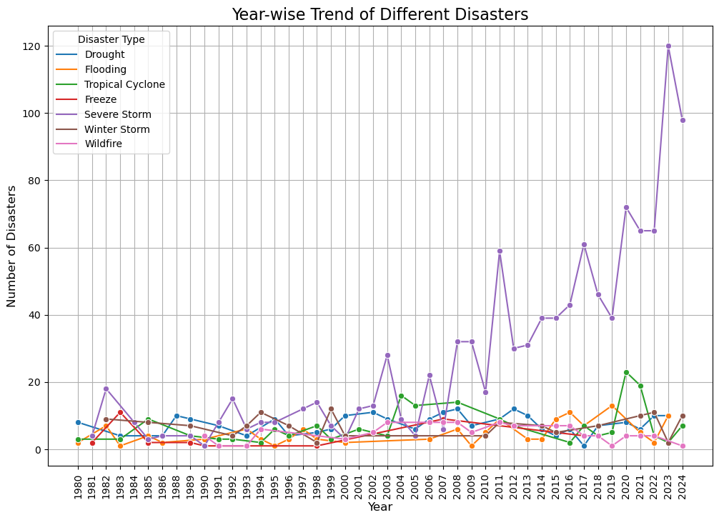
Year-wise Trend of Different Disasters
The graph shows a general upward trend in the frequency of most disaster types over time, indicating an increase in the occurrence of these events.

Slide 22
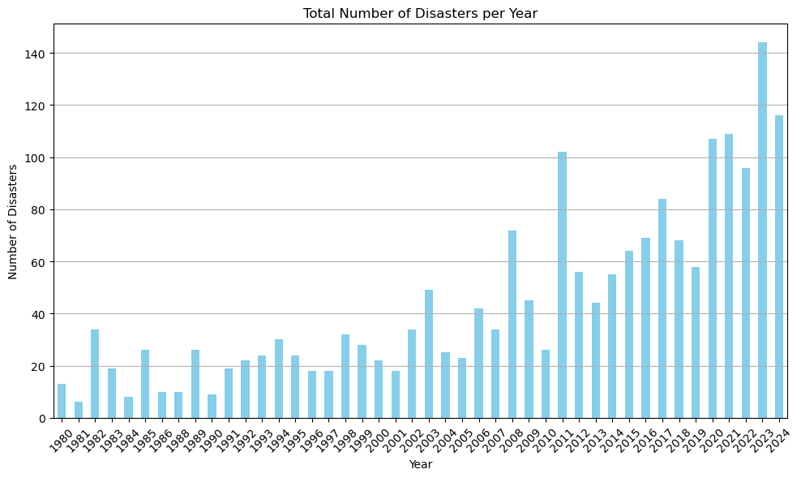
Total Number of Disasters per Year
The increasing number of disasters is linked to climate change, as changing climate patterns can influence the occurrence and severity of various events.

Slide 23
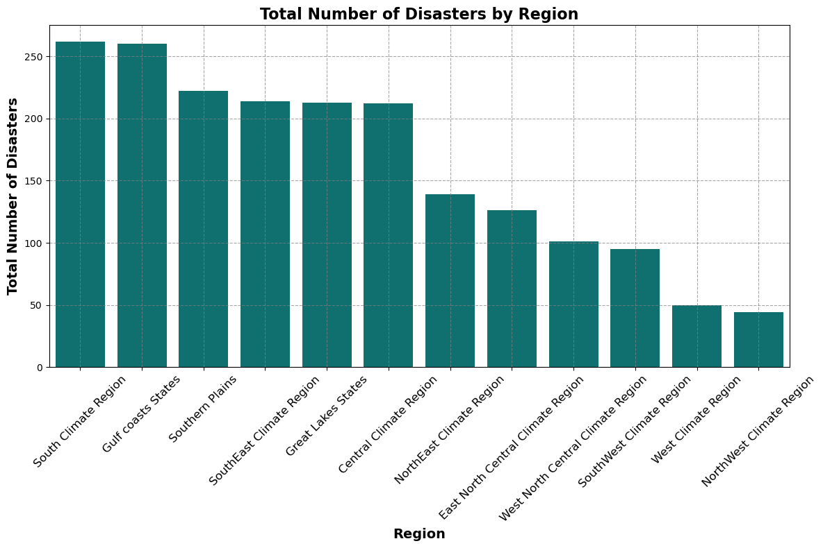
Total Number of Disasters by Region
South Central Climate Region: This region experiences the highest number of disasters, significantly surpassing other regions. Gulf Coast States: The Gulf Coast States also face a relatively high number of disasters.
Lower Disaster Regions: Regions like the West Climate Region and Northwest Climate Region have significantly lower numbers of disasters.

Slide 24
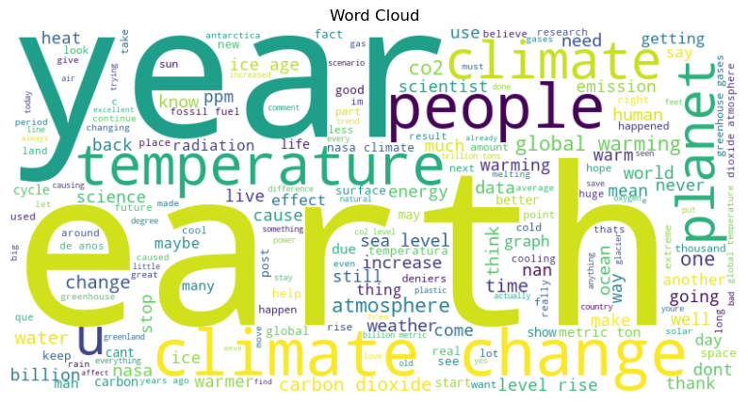
NASA Comment's Semantic Analysis
Climate Change: The word "climate change" is prominently displayed at the centre, indicating that this is the primary focus of the comments.
Temperature: The words "temperature" and "warming" are closely associated with climate change, emphasizing the rising temperatures as a key indicator.
Greenhouse Gases: The terms "greenhouse" and "gases" highlight the role of greenhouse gas emissions in driving climate change.
CO2: The acronym "CO2" is frequently mentioned, emphasizing the significance of carbon dioxide as a major greenhouse gas.
Climate Scientists: The term "scientists" is prominent, suggesting that scientific research and expertise are crucial for understanding and addressing climate change.

Slide 25
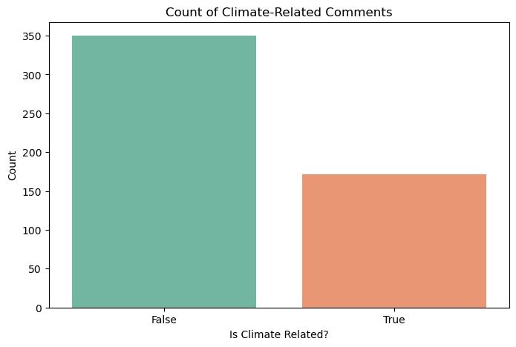
Count of Climate-Related Comments
Overwhelming Minority: The bar representing "True" (climate-related comments) is significantly smaller than the bar representing "False" (non-climate-related comments). This indicates that a vast majority of the comments analyzed are not directly related to climate change.

Slide 26
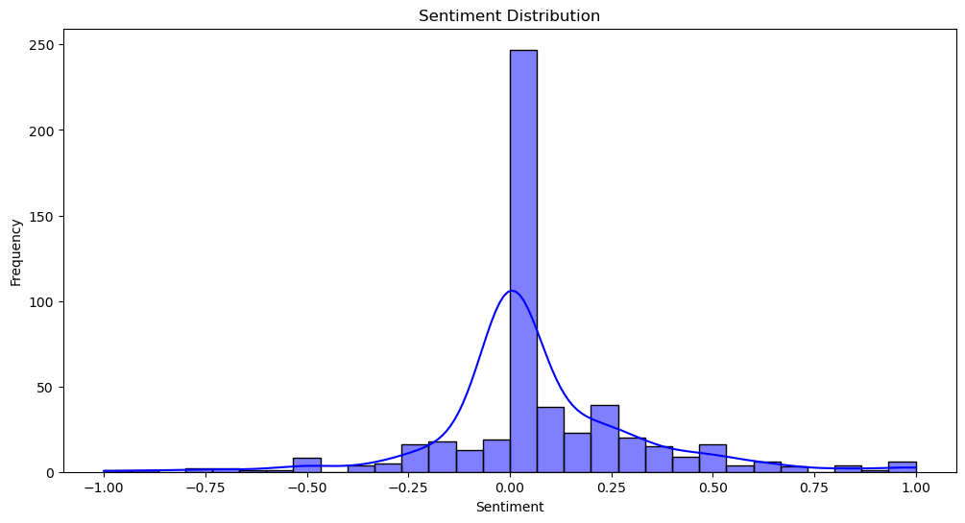
Sentiment Distribution
The distribution is skewed to the right, indicating that there are more positive sentiments (closer to 1.00) compared to negative sentiments (closer to -1.00).

Slide 27
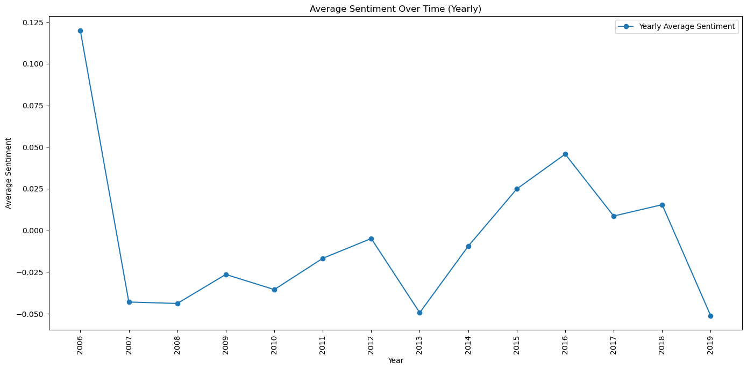
Twitter Dataset Semantic Analysis
Fluctuations: The graph shows a fluctuating trend in average sentiment over time. There is no consistent upward or downward trend, but rather a series of peaks and troughs.
Specific Time Periods:
Positive Peaks: There are several years with notably positive average sentiment, such as 2006, 2011, 2015, and 2016.
Negative Dips: Conversely, there are also years with negative average sentiment, such as 2007, 2010, 2013, and 2019.
Implications:
Dynamic Sentiment: The fluctuating nature of the sentiment suggests that opinions or attitudes have shifted over time, potentially influenced by various factors such as events, news, or trends.

Slide 28
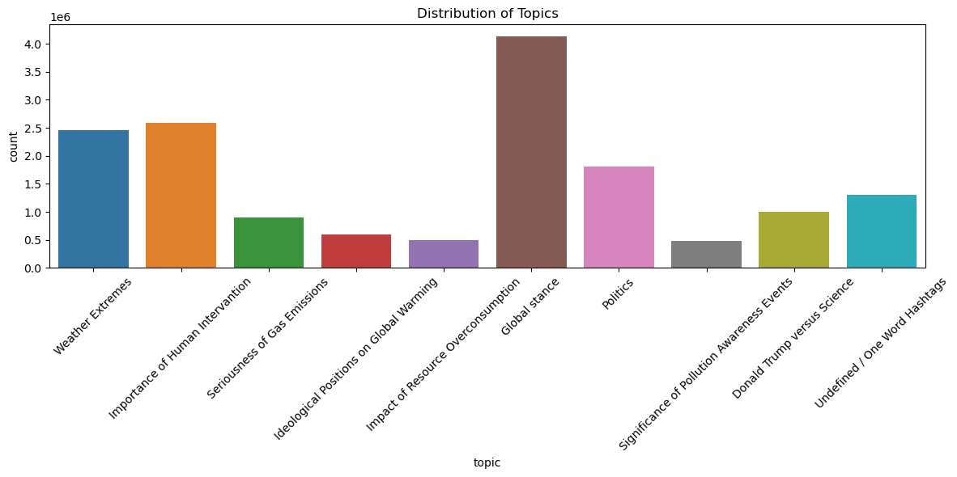
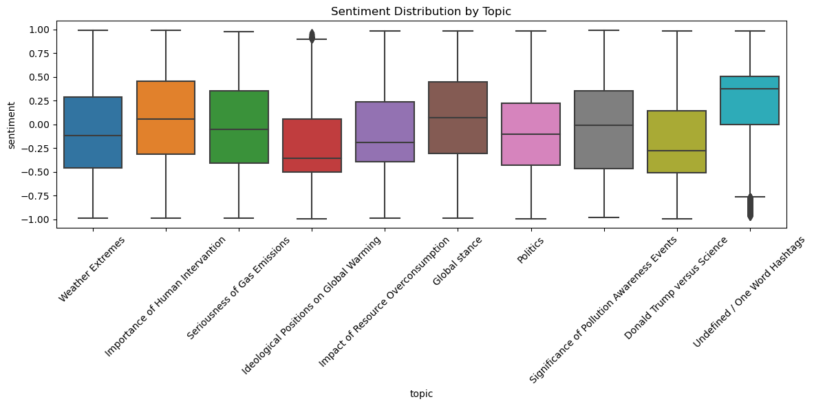
Sentiment Distribution by Topic
The box plots show a wide range of sentiments across the different topics, indicating that there are varying opinions and attitudes within each category. The most discussed topic is ideological positions on global warming. Other frequent topics include weather extremes and human intervention. Less discussed topics include gas emissions, resource overconsumption, global stance, politics, pollution awareness events, and undefined/one-word hash tags.

Slide 29
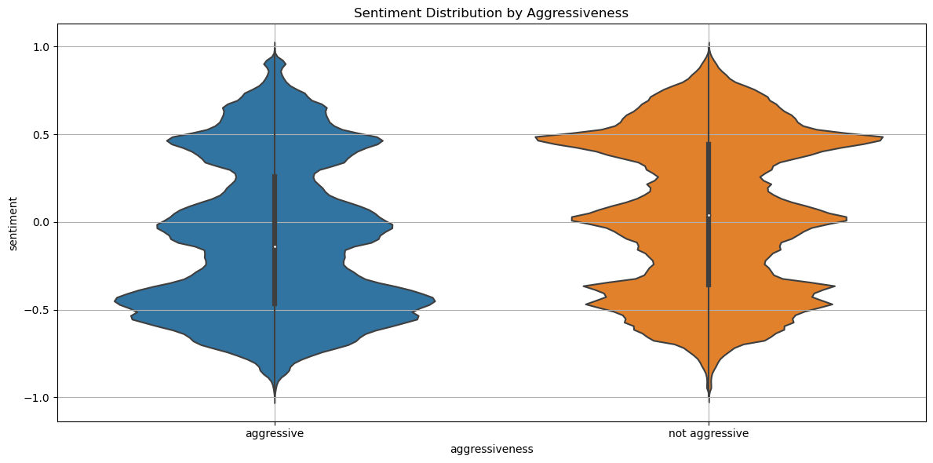
Sentiment Distribution by Aggressiveness
Distinct Distributions: The violin plot clearly shows that the sentiment distributions for "aggressive" and "not aggressive" comments are distinct. Higher Positive Sentiment: The "not aggressive" group appears to have a higher proportion of positive sentiments compared to the "aggressive" group. This is suggested by the violin plot extending further into the positive range for "not aggressive" comments. Lower Negative Sentiment: Conversely, the "aggressive" group seems to have a lower proportion of negative sentiments. The violin plot for "aggressive" comments does not extend as far into the negative range.

Slide 30
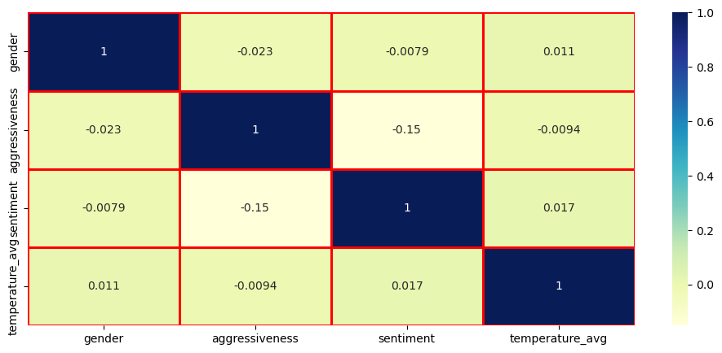
Correlation between Variables affecting Semantic of Comment
Gender and Sentiment: There is a weak positive correlation between gender (female) and sentiment. This suggests that female users may be slightly more likely to express positive sentiments compared to undefined or male users.
Aggressiveness and Sentiment: A moderate negative correlation exists between aggressiveness and sentiment. This indicates that more aggressive comments tend to have a more negative sentiment, while less aggressive comments are more likely to have a positive sentiment.
Temperature and Sentiment: There is a weak positive correlation between temperature_avg and sentiment. This suggests that higher average temperatures may be associated with slightly more positive sentiments.
Other Variables: The remaining correlations between variables are relatively weak, suggesting minimal relationships between them.

Slide 31
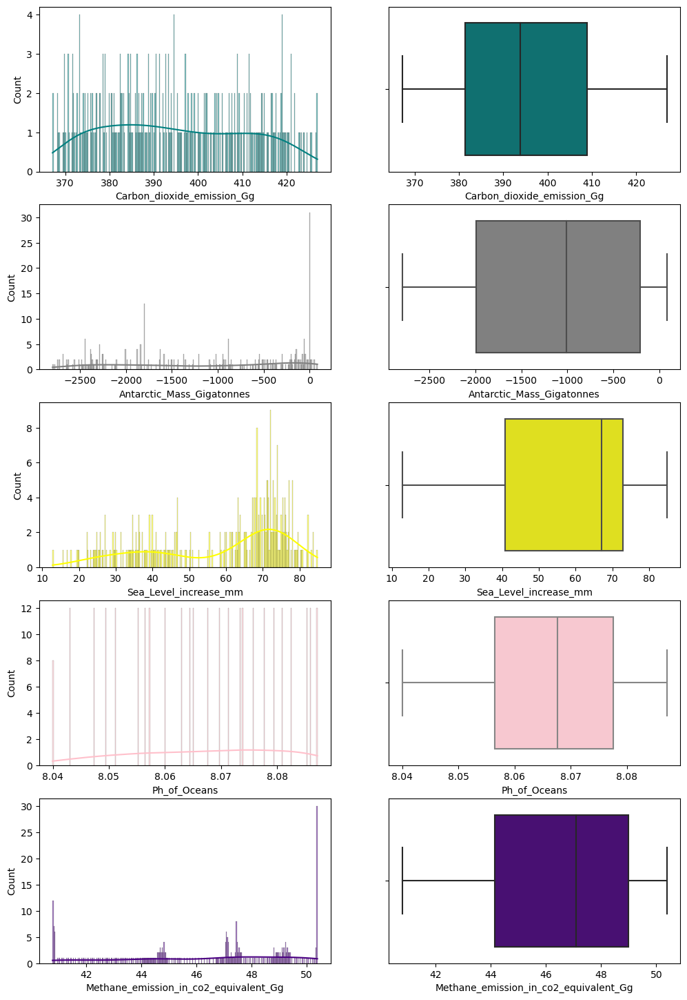
ModelLing
Distributions and Outliers
Carbon Dioxide Emission (Gg): Right-skewed distribution with no outliers.
Antarctic Mass (Gigatonnes): Left-skewed distribution with no outliers.
Sea Level Increase (mm): Right-skewed distribution with no outliers.
pH of Oceans: Relatively normal distribution with no outliers.
Methane Emission (in CO2 Equivalent Gg): Right-skewed distribution with no outliers.

Slide 32
Random Forest to Predict Average Global Temperature
Random forest regressor is not affected y multicollinearity, so no need to check for correlation in independent/Predictor variables.
Target variable: Average_globe_temperature
Predictor Variables:
  Air_Temperature_in_presence_of_Sea_Ice
  Sea_Temperature_in_presence_of_Sea_Ice
  Carbon_dioxide_emission_Gg
  Antarctic_Mass_Gigatonnes
  Sea_Level_increase_mm
  Ph_of_Oceans
  Methane_emission_in_co2_equivalent_Gg
Training Mean Squared Error | 0.00011576404526769248
Training R-squared | 0.9980716941421961
Testing Mean Squared Error | 0.00032593081233589375
Testing R-squared | 0.9950196256271897

Slide 33
Feature Importance for Random Forest Model
Feature | Importance
Ph_of_Oceans | 0.740998
Methane_emission_in_co2_equivalent_Gg | 0.216769
Antarctic_Mass_Gigatonnes | 0.022371
Sea_Level_increase_mm | 0.010838
Air_Temperature_in_presence_of_Sea_Ice | 0.005860
Carbon_dioxide_emission_Gg | 0.002400
Sea_Temperature_in_presence_of_Sea_Ice | 0.000764
Ph of Oceans : The most important feature, significantly impacting predictions related to climate dynamics.
Methane emission: The second most important, highlighting the role of greenhouse gases in climate modelling.
Antarctic Mass: Lower importance but still relevant, indicating the significance of Antarctic ice mass.
Sea Level increase: Contributes less compared to top features, but still important due to its implications for sea level rise.
Air Temperature in presence of Sea Ice : Minor contribution, suggesting limited influence on predictions.
Carbon dioxide emission: Minimal importance, possibly due to redundancy with other features.
Sea Temperature in presence of Sea Ice : The least important feature, showing little impact on the model's predictions.

Slide 34
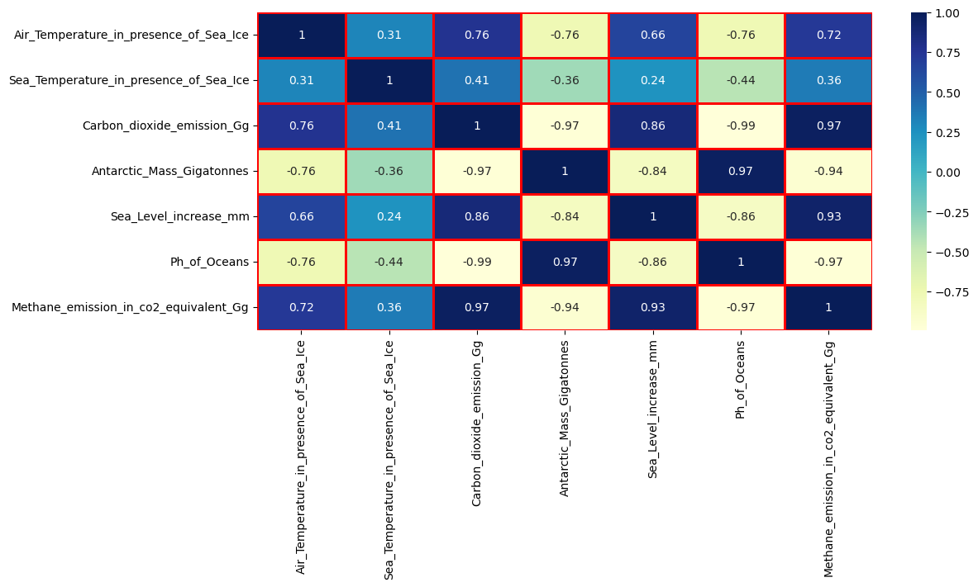
Multiple Linear Regression Modelling
Air Temperature & Sea Temperature: These temperatures tend to increase or decrease together.
Carbon Dioxide & Methane Emission: Extremely high correlation, indicating they closely track each other.
Sea Level Increase & Methane Emission: Increases in one often coincide with increases in the other.
Antarctic Mass & Carbon Dioxide Emission: As CO2 emissions rise, Antarctic mass tends to decrease.
Antarctic Mass & Methane Emission: Similar negative relationship; increasing methane emissions are associated with decreasing Antarctic mass.
Sea Level Increase & pH of Oceans : Higher sea levels correlate with lower ocean pH levels.

Slide 35
Variance of Predictors and their Variance Inflation Factor after performing Standardization on each variables.
Variables | Variance | VIF | VIF after dropping Ph_Ocean
Air_Temperature_in_presence_of_Sea_Ice | 0.042984 | 2.51839 | 1.37842
Sea_Temperature_in_presence_of_Sea_Ice | 0.000083 | 1.592917 | 1.21168
Carbon_dioxide_emission_Gg | 264.7703 | 70.80480 | 6.57105
Antarctic_Mass_Gigatonnes | 862874.2460 | 18.83594 | 4.53717
Sea_Level_increase_mm | 346.4305 | 9.24200 | 1.66837
Ph_of_Oceans | 0.000179 | 96.48279
Methane_emission_in_co2_equivalent_Gg | 9.2501 | 42.5557 | 4.88403
VIF is a measure used to detect multicollinearity in regression analysis. It quantifies how much the variance of a regression coefficient is inflated due to multicollinearity with other predictors.
VIF = 1: No correlation between a predictor and other variables (ideal).
1 < VIF < 5: Moderate correlation, usually acceptable.
VIF ≥ 5: High correlation, may indicate problematic multicollinearity.
VIF ≥ 10: Very high correlation, often suggests the need for corrective action (e.g., removing or combining variables).

Slide 36
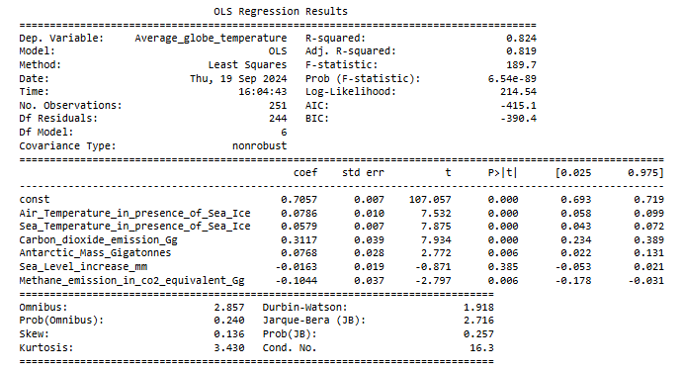
Ordinary Least Square Regression Result
R-squared (0.824): Indicates that 82.4% of the variance in the dependent variable (Average Globe Temperature) is explained by the independent variables in the model.
Adjusted R-squared (0.819): Adjusted for the number of predictors; a high value indicates a good fit.

Slide 37
F-statistic: 189.7
This statistic tests the overall significance of the model. The low p-value (6.54e-89) suggests that the model is statistically significant.
Air Temperature in Presence of Sea Ice (0.0786): (p < 0.0001)A significant positive relationship, meaning higher air temperatures contribute positively to globe temperature.
Sea Temperature in Presence of Sea Ice (0.0579): (p < 0.0001)Also positively impacts globe temperature.
Carbon Dioxide Emission (Gg) (0.3117): (p < 0.0001)A significant predictor, indicating that increased CO2 emissions strongly correlate with higher globe temperatures.
Antarctic Mass (Gigatonnes) (0.0768): (p = 0.006)Positive relationship, although less influential compared to CO2.
Sea Level Increase (mm) (-0.0163): (p = 0.385)Not statistically significant; does not contribute meaningfully to the model.
Methane Emission (in CO2 equivalent Gg) (-0.1044): (p = 0.006)A significant negative relationship, suggesting increased methane emissions are associated with lower globe temperatures.
Durbin-Watson Statistic (1.918): Close to 2, suggesting no significant autocorrelation in residuals.
Omnibus Test (2.857): (p = 0.240)Indicates that the residuals are normally distributed; not statistically significant.

Slide 38
Accuracy of MLR Model
Metric | Training Data | Testing Data
Mean Absolute Error (MAE) | 0.0785 | 0.0762
Mean Squared Error (MSE) | 0.0106 | 0.0093
Root Mean Squared Error (RMSE) | 0.1029 | 0.0967
R-squared | 0.8235 | 0.8572
Mean Absolute Error (MAE): Measures the average absolute difference between predicted and actual values. Lower values indicate better accuracy.
Mean Squared Error (MSE): Calculates the average of the squares of the errors (differences between predicted and actual values). It penalizes larger errors more than MAE, so lower values are preferable.
Root Mean Squared Error (RMSE): The square root of MSE, providing error in the same units as the original data. It gives an idea of the magnitude of errors, with lower values indicating better fit.
R-squared (R²): Represents the proportion of variance in the dependent variable that can be explained by the independent variables in the model. Values range from 0 to 1, with higher values indicating a better fit.
MAE: Low values indicate accurate predictions, with testing data slightly better than training.
MSE & RMSE: Both lower for testing, showing good generalization to unseen data.
R-squared: High values suggest that a significant portion of variance is explained by the model, with improved performance on testing data.

Slide 39
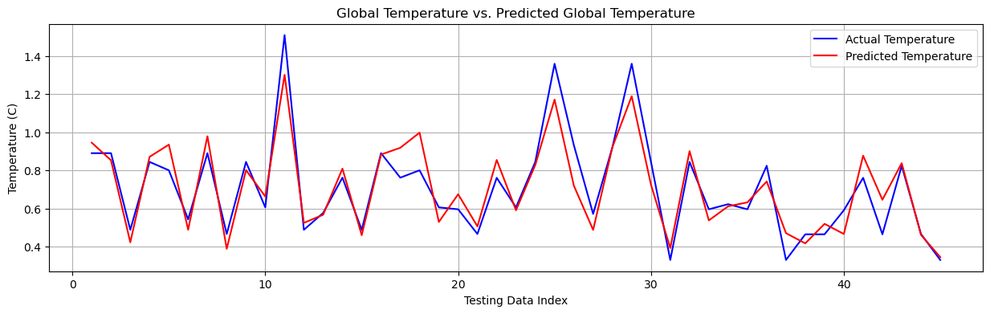
Global Temperature vs. Predicted Global Temperature
Close Correlation: The actual and predicted temperature lines are closely aligned, suggesting that the model is accurately capturing the general trend in global temperature.
Fluctuations: Both lines exhibit fluctuations, indicating that the model is able to capture some of the short-term variations in temperature.
Predicted Average Global Temperature = 0.7057 + 0.0786(Air_Temperature_in_presence_of_Sea_Ice) + 0.0579(Sea_Temperature_in_presence_of_Sea_Ice) + 0.3117(Carbon_dioxide_emission_Gg) + 0.0768(Antarctic_Mass_Gigatonnes) - 0.0163(Sea_Level_increase_mm) - 0.1044(Methane_emission_in_co2_equivalent_Gg)

Slide 40
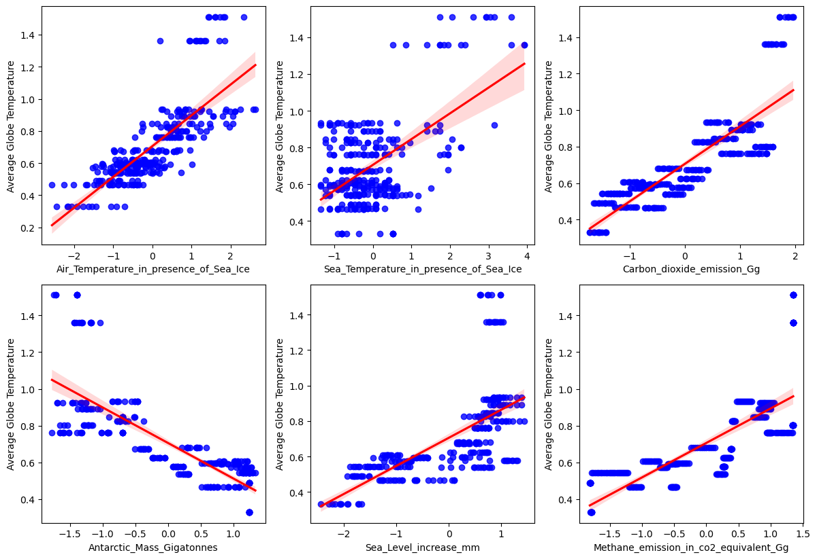
Checking Assumptions of MLR Model
1. Dependent and Independent variables should be Linearly related
Some variables (like Carbon Dioxide Emission and Antarctic Mass) exhibit a strong linear relationship.
Other variables (like Sea Temperature and Methane Emission) show weaker linear relationships with more scattered data points.

Slide 41
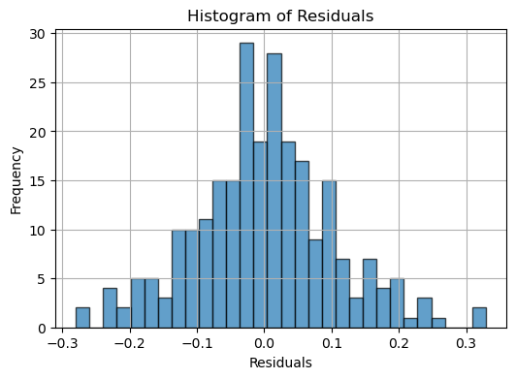
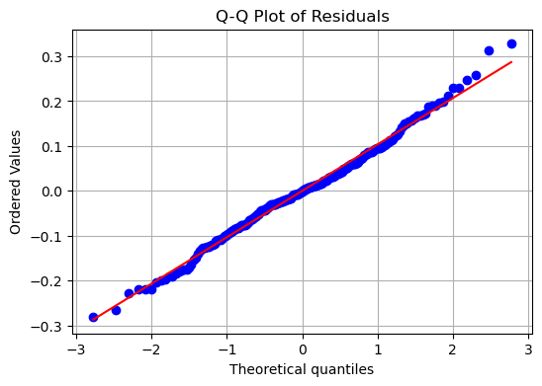
2. Residuals should follow normal distribution
From above histogram and Q-Q plot it’s seems like residuals follow normal distribution, lets check with Shapiro-Wilk test for confirmation.
The Shapiro-Wilk test is a statistical test used to assess the normality of a dataset. It tests the null hypothesis that a sample comes from a normally distributed population.
Shapiro-Wilk Test Statistic: 0.9922977685928345, p-value: 0.2159295529127121 Residuals appear to follow a normal distribution (fail to reject H0).

Slide 42
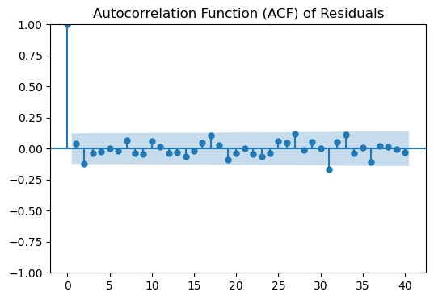
3. No Autocorrelation i.e. residuals should not be independent
The ACF plot shows that the residuals are generally within the blue confidence bands, indicating that there is no significant autocorrelation present. This suggests that the residuals are independent.
The another statistical method is Durbin-Watson (DW) statistic, is a test statistic used to detect the presence of autocorrelation (specifically, first-order autocorrelation) in the residuals from a regression analysis. It ranges from 0 to 4.
DW ≈ 2: No autocorrelation, DW < 2: Positive autocorrelation and DW > 2: Negative autocorrelation.
Durbin-Watson Statistic: 1.9180719942256892, This value is close to 2, suggesting that there is no significant autocorrelation in the residuals. It indicates that the model's residuals are likely independent, which is a good sign for the validity of the regression analysis.

Slide 43
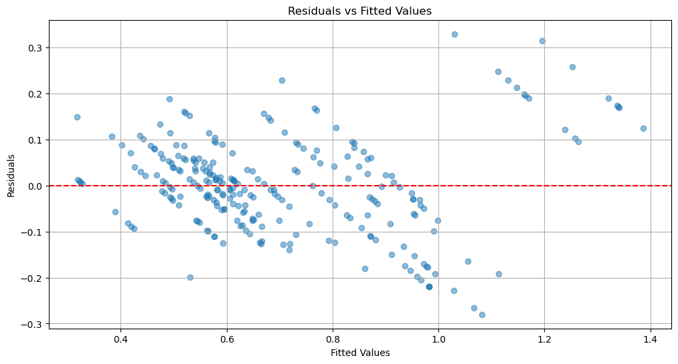
Homoscedasticity
Homoscedasticity refers to a property of a regression model in which the variance of the residuals (errors) is constant across all levels of the independent variable(s). It is an important assumption in linear regression analysis.
The residuals vs. fitted values plot indicates that the assumption of homoscedasticity is likely met in this case.
The Statistical method-
Goldfeld-Quandt test statistic: 0.8897 and Goldfeld-Quandt p-value: 0.7377, Since the test statistic is close to 1 and the p-value is high, this indicates that the residuals of regression model exhibit constant variance (homoscedasticity).

Slide 44
LSTM (Long Short-Term Memory) Modelling
LSTM (Long Short-Term Memory) is a type of recurrent neural network (RNN) architecture specifically designed to learn from sequences of data, making it particularly effective for time series prediction, natural language processing, and other tasks involving sequential data.
Trainable Parameters-
  1. Number of Units (Neurons): The number of LSTM cells in the layer. More units can capture more complex patterns but may lead to over fitting.
  2. Input Shape: The shape of the input data, typically defined as (time steps, features).
  3. Batch Size: The number of samples processed before the model is updated.
  4. Epochs: The number of complete passes through the training dataset.
  5. Learning Rate: The step size at each iteration while moving toward a minimum of the loss function.
  6. Dropout Rate: The fraction of neurons to drop during training to prevent over fitting.
  7. Activation Functions: Functions applied to the output of each LSTM cell.
  8. Optimizer: The algorithm used to update the model weights.
  9. Sequence Length (Time Steps): The number of previous time steps the model looks at to make predictions.
  10. Number of Layers: The depth of the LSTM network

Slide 45
Model Parameters and Accuracy
Number of LSTM cells in this layer = 50
Dropout Rate = 0.2
Optimizer = adam
Loss Function: 'mean squared error‘
Epochs: 200
Batch Size: 32
Verbose: 1
Variable | Mean Squared Error | Mean Absolute Error | R-squared (R²)
Average_globe_temperature | 0.0031 | 0.0377 | 0.9472
Air_Temperature_in_presence_of_Sea_Ice | 0.0111 | 0.0824 | 0.7224
Sea_Temperature_in_presence_of_Sea_Ice | 0.0000 | 0.0046 | 0.5781
Carbon_dioxide_emission_Gg | 4.9837 | 1.8751 | 0.9801
Antarctic_Mass_Gigatonnes | 15073.4391 | 96.3143 | 0.9821
Sea_Level_increase_mm | 22.4127 | 3.5912 | 0.9268
Ph_of_Oceans | 0.0000 | 0.0008 | 0.9942
Methane_emission_in_co2_equivalent_Gg | 0.0764 | 0.2313 | 0.9910

Slide 46
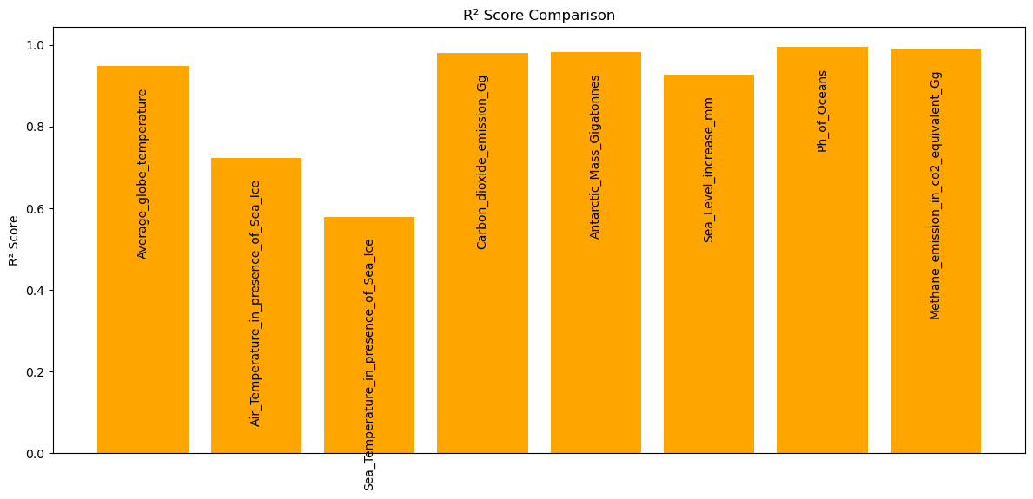
R² Comparison of all Variables
The LSTM model appears to capture strong time-dependent relationships for variables like Ph_of_Oceans, Methane_emission_in_co2_equivalent_Gg, and Antarctic_Mass_Gigatonnes, while struggling somewhat with more volatile or weakly correlated variables like the air and sea temperatures near sea ice. This suggests that ocean and greenhouse gas-related variables might have clearer temporal patterns that the LSTM can learn from.

Slide 47
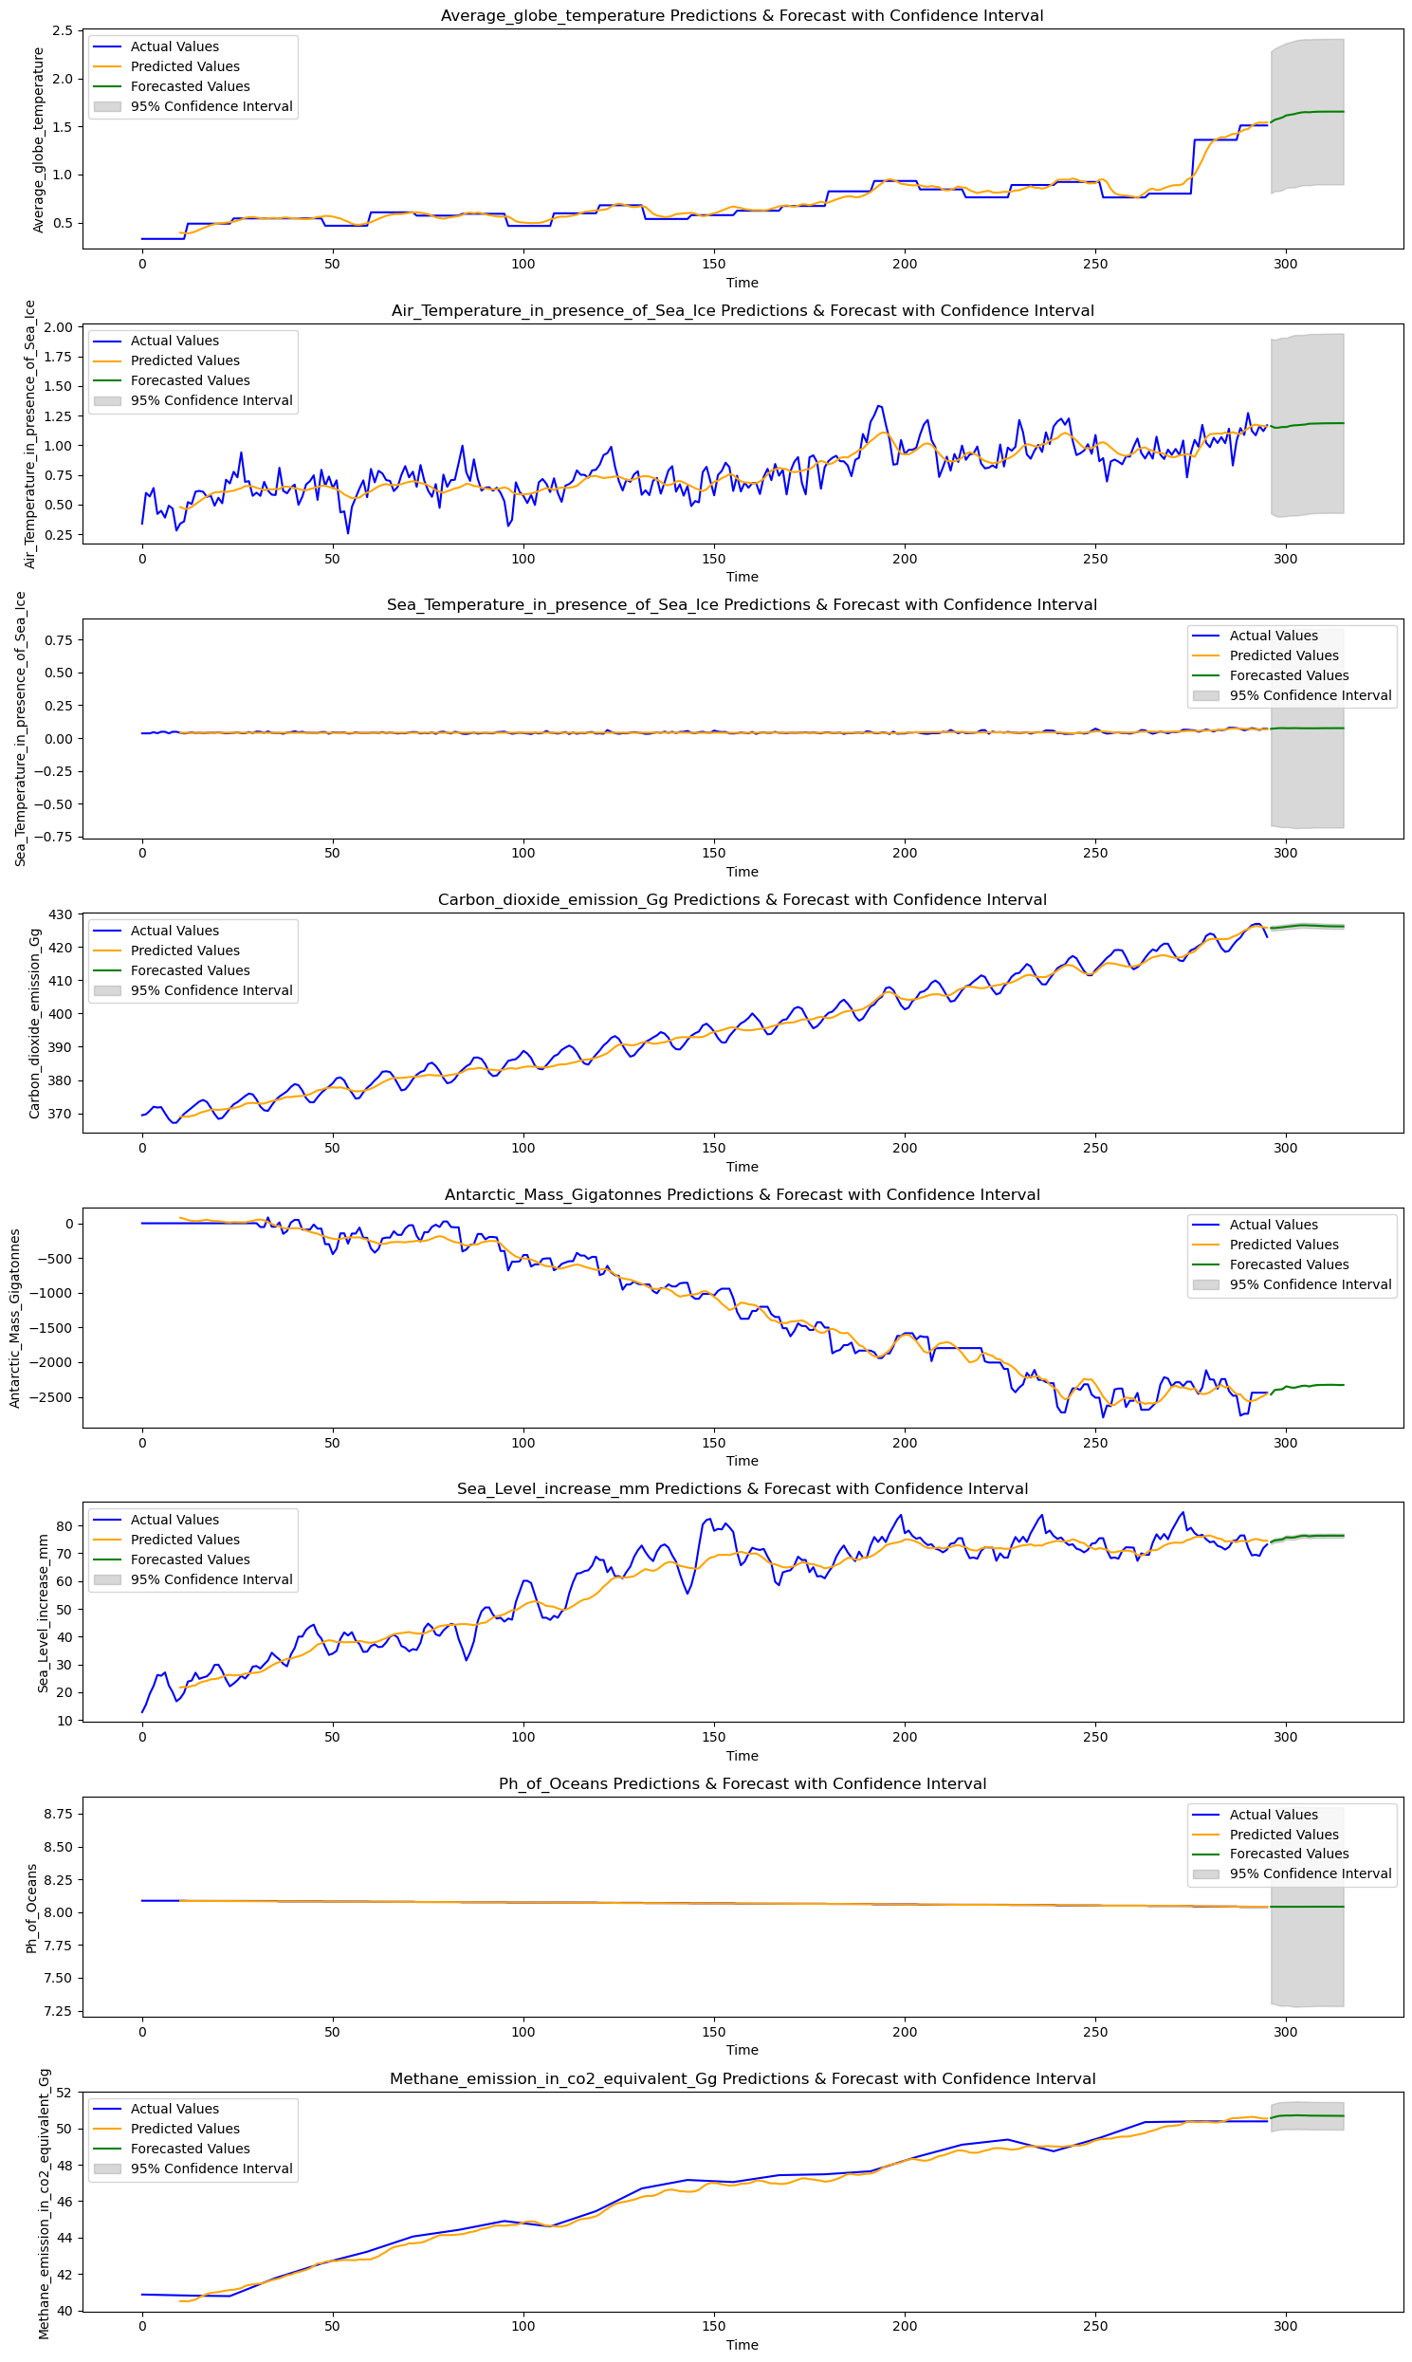
Forecast of variables

Slide 49
Trend Capture: The LSTM model performs well in capturing the trends of variables like Average_globe_temperature, Carbon_dioxide_emission_Gg, and Methane_emission_in_co2_equivalent_Gg, with high R² scores.
Uncertainty: Variables such as Air_Temperature_in_presence_of_Sea_Ice and Sea_Level_increase_mm show wider confidence intervals, indicating more uncertainty in their predictions.
Stability: Variables such as Sea_Temperature_in_presence_of_Sea_Ice and Ph_of_Oceans appear stable over time, with narrow confidence intervals and little deviation in their future forecasts.
This analysis suggests that while the LSTM model effectively captures the general trends, certain variables exhibit more variability and are more difficult to predict with precision.

Slide 50
References
https://data.giss.nasa.gov/gistemp/
https://climate.nasa.gov/vital-signs/ice-sheets/?intent=121
https://berkeley-earth-temperature.s3.us-west-1.amazonaws.com/Global/Land_and_Ocean_complete.txt
https://climate.nasa.gov/vital-signs/carbon-dioxide/?intent=121
https://tradingeconomics.com/country-list/temperature
https://climate.nasa.gov/vital-signs/sea-level/?intent=121
https://www.ncei.noaa.gov/access/billions/events/TA/1980-2024?disasters[]=all-disasters
https://marine.copernicus.eu/ocean-climate-portal/ocean-acidification
https://www.epa.gov/climate-indicators/climate-change-indicators-heat-waves
https://ourworldindata.org/grapher/methane-emissions?tab=table
CODE: https://github.com/21AnkurSingh2000/Climate_Modelling/blob/main/Climate%20Change%20Modelling.ipynb

